Slide 1
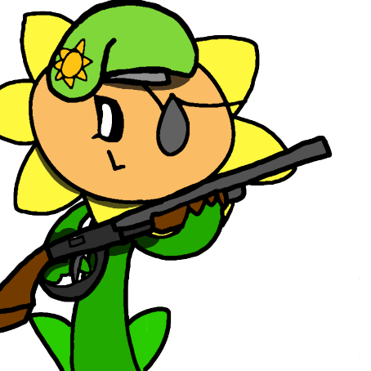
ZOMBIE WAR
Project Synopsis Presentation
Date: 12/07/2001
Bachelor of Computer Application
Project by:
Satakshi Shanvi
UNIVERSITY INSTITUTE OF COMPUTING
CHANDIGARH UNIVERSITY

Slide 2
Team Details
Student Name | Role
Satakshi Shanvi | Developer, Testing etc.
Shrey Dikshant | Developer, Testing etc.
2

Slide 3
Project Brief
The game has three main Components :- Zombies ^O^ ^o^, Battlefield And the Rival *x*
Zombies are arrogant because the battlefield belongs to them and they have a huge army.
Before the game starts
Zombies ask the rival to enter his ‘name’ and the ‘number of zombies’ the rival wants to fight
The rival fights against normal zombies and the ancient zombies
As the name suggests the ancient zombies are old and much more powerful
If the rival wins against the zombies and survives, he wins the game
The zombies will retreat and the battlefield will be owned by the rival
But if the rival dies
The zombies will wait for the next rival
Because zombies are always ready to fight!!
3

Slide 4
Methodologies/ Technologies/ Tools to be used
Compiler: VS Code
Object Oriented programming language
Extension: .cpp
Header files: <iostream> <unistd.h> <time.h>
Functions: main , createZombie , message
4

Slide 5
Projects Functions/ modules
int main ( )
int createZombie ( )
void message ( )
5

Slide 6
Flow Chart
START
zombiesKilled == zombieCount
INPUT-
playerName, zombieCount
yes
no
OUTPUT-
(message from zombie)
user’s victory message
Zombie’s victory message
playerAlive &&
zombiesKilled < zombieCount
no
OUTPUT-
score board
yes
playerSkill < zombieSkill
STOP
yes
no
OUTPUT-
(message)
zombiesKilled++
OUTPUT-
(message)
playerAlive=false
6

Slide 7
\
Advantage of The Project
The game is interactive
It is easy to play
Stress relief
Enhance motivation
Easy to understand code
7

Slide 8
\
What you have learned
In this project:-
Header Files:
    <iostream>
    <unistd.h>
    <time.h>
While loop
Functions:
    User defined
    Library/ built-in functions
Conditional Statements (if else if)
8

Slide 9
References, if any
References
Web links:
Gist. 2021. A simple game in C++ for a class exercise.. [online] Available at: <https://gist.github.com/sagebind/8358734> [Accessed 6 July 2021].
9

